Slide 1


Data Science & Analytics Capstone Project
Presented by Group 11, this analysis delves into the core dynamics of a superstore's business operations, leveraging data-driven insights to uncover key areas for strategic improvement and growth.
sI
by sulayk Iddrisu
MARCH COHORT
19th July, 2025

Slide 2
Presentation Outline
1
Group Members
Introducing the team behind the analysis.
2
Problem Statement
Defining the core challenges faced by the superstore.
3
Objectives
Outlining the specific goals of our data analysis.
4
Methodology
Detailing the tools and framework used for data processing.
5
Sales Dashboard
Showcasing the interactive visualization of sales data.
6
Analysis
Presenting the findings derived from the data.
7
Insights
Translating data findings into actionable knowledge.
8
Recommendations
Proposing strategic actions for business growth.

Slide 3

Problem Statement: Unlocking Superstore’s Performance
A prominent superstore seeks a deeper understanding of its operational effectiveness. Our primary challenge is to identify key performance drivers across products, regions, categories, and customer segments. This analysis will inform strategic decisions on which areas to prioritize for growth and which to de-emphasize to optimize resource allocation.

Slide 4





Key Objectives
Regional Revenue Analysis
Presenting revenue distribution across different geographic regions.
Top Category Identification
Identifying the top 3 product categories and sub-categories.
Profit by Segment Comparison
Comparing profit margins versus sales quantity across customer segments.
Targeted Growth Areas
Pinpointing products, regions, categories, and segments for strategic focus or avoidance.

Slide 5
Methodology: Our Data-Driven Approach
Data Tools
Data Framework
Microsoft Excel: For initial data handling and organization.
Inspect Data Source
Power BI Desktop: For advanced data modeling and visualization.
Initial review of the raw .csv database.
Data Extraction
Using Power Query Editor to pull relevant data.
Data Transformation
Data Description
Cleaning and refining data for analysis.
Superstore Dataset: Comprising 9994 rows of transactional data.
21 Columns: Encompassing various attributes including sales, profit,
and product details.
Data Loading
Importing processed data into Power BI.
Data Models & Measures
Building relationships and calculations for robust insights.
Visualization
Creating interactive dashboards for clear presentation.

Slide 6
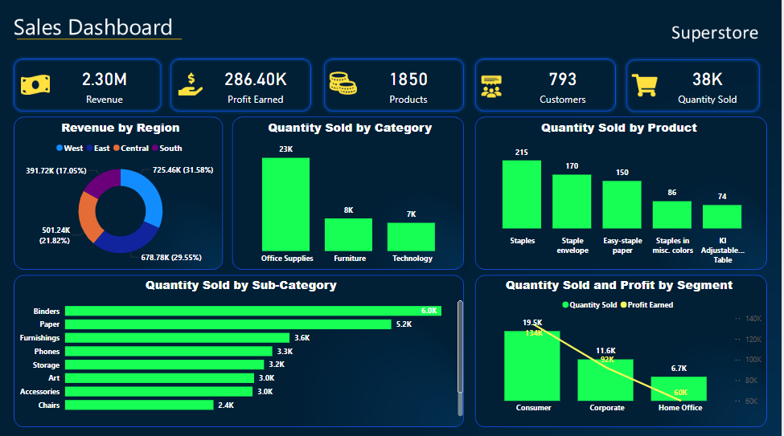

Slide 7
Analytical Findings
31.6%
17.1%
West Region Revenue
South Region Revenue
Highest revenue at $725.46K, indicating strong market presence.
Lowest revenue at $391.72K, suggesting potential areas for growth initiatives.
23K
7K
Office Supplies Quantity
Technology Quantity
Highest quantity sold, reflecting high demand for essential items.
Lowest quantity sold, highlighting potential for strategic promotion or repositioning.
19.5K
6.7K
Consumer Segment Sales
Home Office Sales
Highest sales and profit ($134K), confirming its critical importance.
Lowest sales and profit ($60K), requiring re-evaluation of strategies.

Slide 8
Insights: Unpacking Superstore's Performance Metrics
Our analysis revealed several critical insights into the superstore's financial health and operational efficiency. These findings pinpoint key areas of success and opportunities for improvement.
Overall Financials
Customer & Product Reach
Regional Profitability
Total Revenue: $2.3M
1,850 distinct Products sold
West Region: Most profitable, with $108.42K profit
Total Quantity Sold: 38K items
793 unique Customers served
Total Profit Earned: $286.4K
This region is a cornerstone for sustained profitability.
Category Profitability
Top Product Profit
Technology Category: Highest profits at $145K, despite lower quantity sold.
Easy-staple Paper: Achieved the most profit, $1.1K.
Identifies a key product driving significant returns.
Highlights high-value product segments.

Slide 9




Recommendations: Guiding Future Success
Our recommendations are meticulously aligned with the recorded sales and profit variables, focusing on specific products, regions, categories, and customer segments to target for optimized performance.
Prioritize Easy-staple Paper
Focus on the West Region
As the product with the highest accrued profit ($1.1K), Easy-staple Paper should be consistently prioritized in sales and marketing efforts to maximize returns.
The West is the most profitable region, generating $108.42K in profit. Superstore should strategically invest more resources and sales efforts into this area, leveraging its proven profitability.
Emphasize Technology Category
Boost Consumer Segment Production
Despite lower sales quantity, the Technology category generated the highest profit ($145K). This high-value segment requires increased attention, potentially through targeted marketing or premium service offerings.
The Consumer Segment is the most profitable. Therefore, Superstore should align production and inventory management to cater more effectively to this segment's demands, ensuring sustained growth.

Slide 10
THANK YOU FOR YOUR ATTENTION!
THE END

